Slide 1
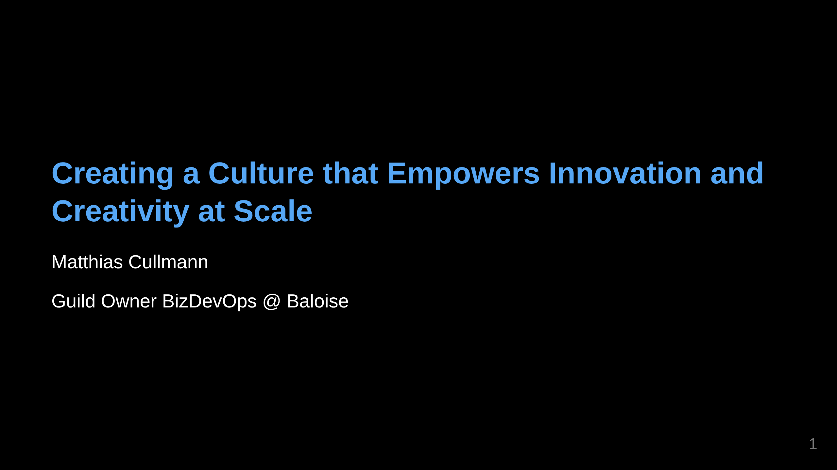
Notes:
All Job Titles are wrong, but some are useful. -> Im from IT Insurance is in fact IT with an insurance twist.

Slide 2

Notes:
Culture is the shared beliefs, values, customs, behaviors, and artifacts that characterize a group or society and are transmitted across generations. Culture with capital C - millenaires. Culture is how we do things around here. Photo by <a href="https://unsplash.com/@rylouma?utm_source=unsplash&utm_medium=referral&utm_content=creditCopyText">Marylou Fortier</a> on <a href="https://unsplash.com/photos/two-pyramid-during-golden-hour-DYMC1mP3HS4?utm_source=unsplash&utm_medium=referral&utm_content=creditCopyText">Unsplash</a>

Slide 3
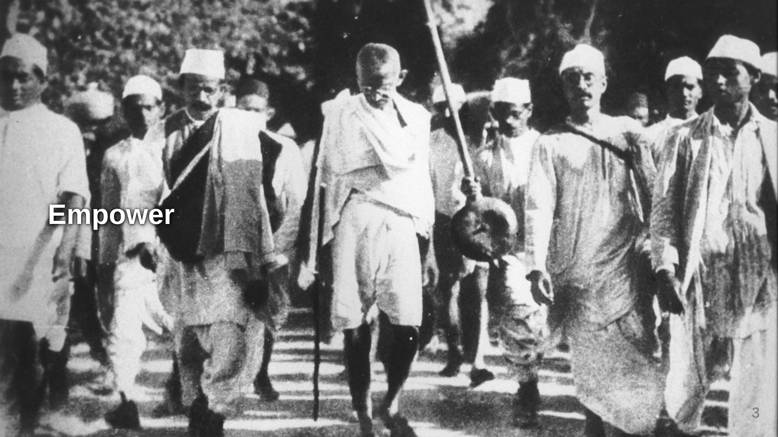
Notes:
Sorry, image for NY

Slide 4
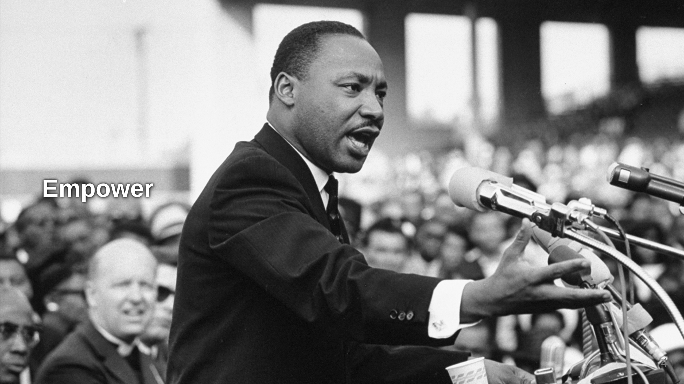

Slide 5
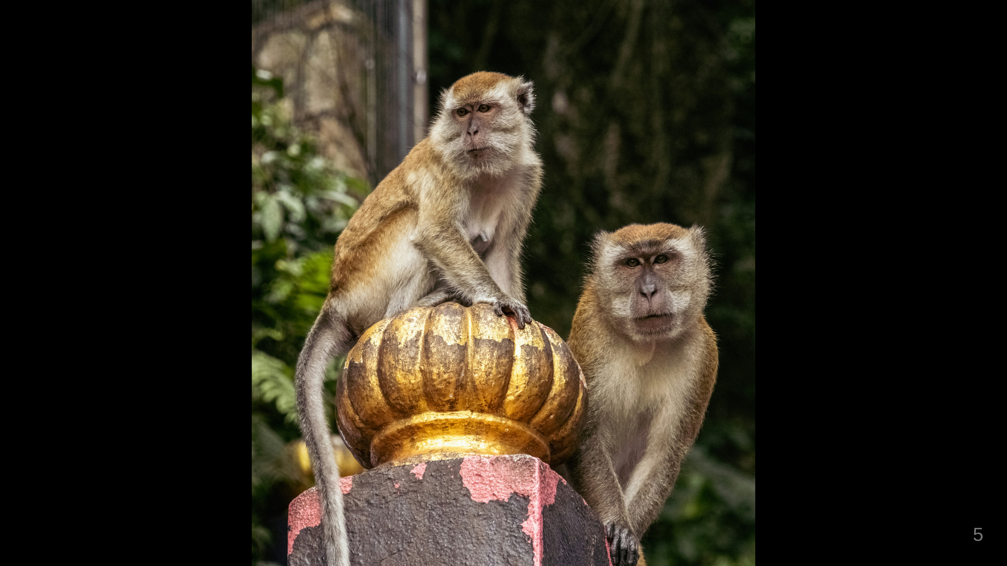
Notes:
Let your people take control and don't be afraid to see the symbols of power slightly deteriorate. Get out of the way. Photo by <a href="https://unsplash.com/@aarsoph?utm_source=unsplash&utm_medium=referral&utm_content=creditCopyText">Kristijan Arsov</a> on <a href="https://unsplash.com/photos/two-monkeys-sitting-on-top-of-a-golden-statue-2vkUywv7LNQ?utm_source=unsplash&utm_medium=referral&utm_content=creditCopyText">Unsplash</a>

Slide 6
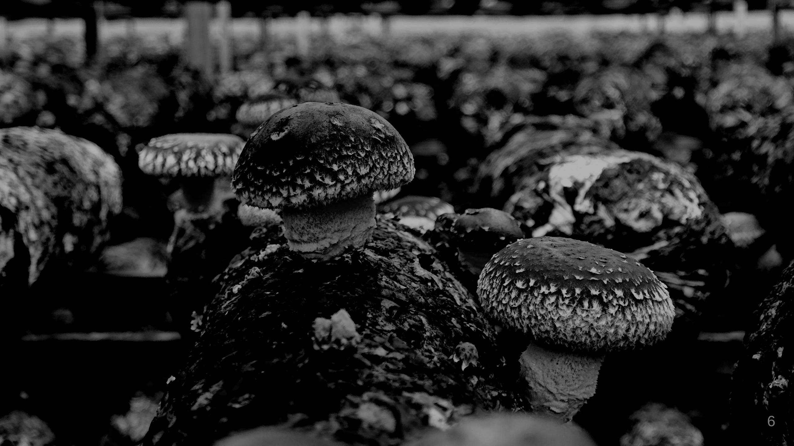
Notes:
Information, Openness wiki open friday Insurance is data and knowledge. Data classification and Openness Take the fear away. FOSS Photo by <a href="https://unsplash.com/@yaooo_?utm_source=unsplash&utm_medium=referral&utm_content=creditCopyText">yao oo</a> on <a href="https://unsplash.com/photos/a-bunch-of-mushrooms-that-are-on-a-shelf-p_Bpv-iu7QI?utm_source=unsplash&utm_medium=referral&utm_content=creditCopyText">Unsplash</a>

Slide 7

Notes:
Internal vs External Innovation

Slide 8

Notes:
Failure ==> So how do we do that?

Slide 9

Notes:
Creativity is the foundational mental capacity to generate novel ideas, connections, or perspectives. It's about thinking differently, seeing patterns others miss, or imagining possibilities that don't yet exist. Creativity is cognitive and abstract—it happens in your mind when you make unexpected associations or challenge conventional thinking. For example, wondering "what if we could carry a thousand songs in our pocket?" is creative thinking. Photo by <a href="https://unsplash.com/@bhushan07?utm_source=unsplash&utm_medium=referral&utm_content=creditCopyText">Bhushan Sadani</a> on <a href="https://unsplash.com/photos/bokeh-light-photo-M-xaOaCzy_M?utm_source=unsplash&utm_medium=referral&utm_content=creditCopyText">Unsplash</a>

Slide 10
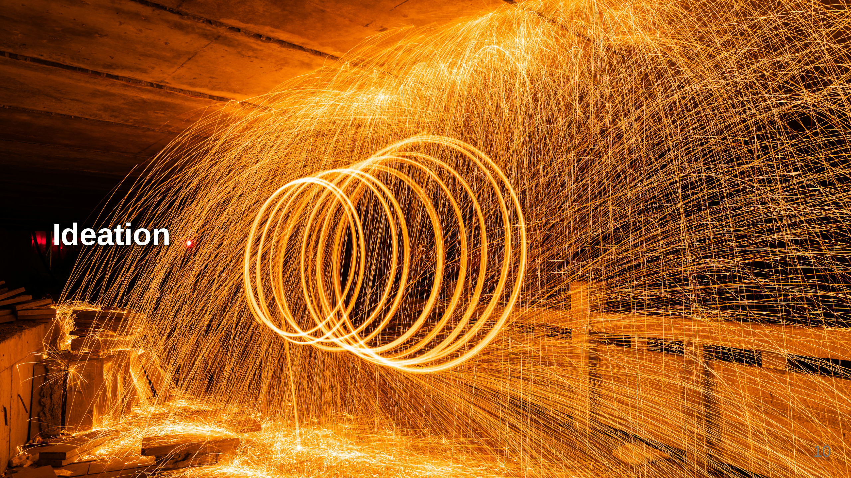
Notes:
Ideation is the systematic process of generating, developing, and communicating ideas. It's creativity in action—the deliberate practice of producing and refining concepts. Ideation typically involves techniques like brainstorming, mind mapping, or design thinking workshops. It takes raw creative impulses and shapes them into more concrete concepts that can be evaluated and refined. Using the earlier example, ideation would involve sketching out different ways a portable music device might work, considering user needs, and exploring various technical approaches. Photo by <a href="https://unsplash.com/@dynastywind?utm_source=unsplash&utm_medium=referral&utm_content=creditCopyText">Lyndon Li</a> on <a href="https://unsplash.com/photos/a-long-exposure-photo-of-sparks-in-a-tunnel-EHMTGqCw7Xc?utm_source=unsplash&utm_medium=referral&utm_content=creditCopyText">Unsplash</a>

Slide 11
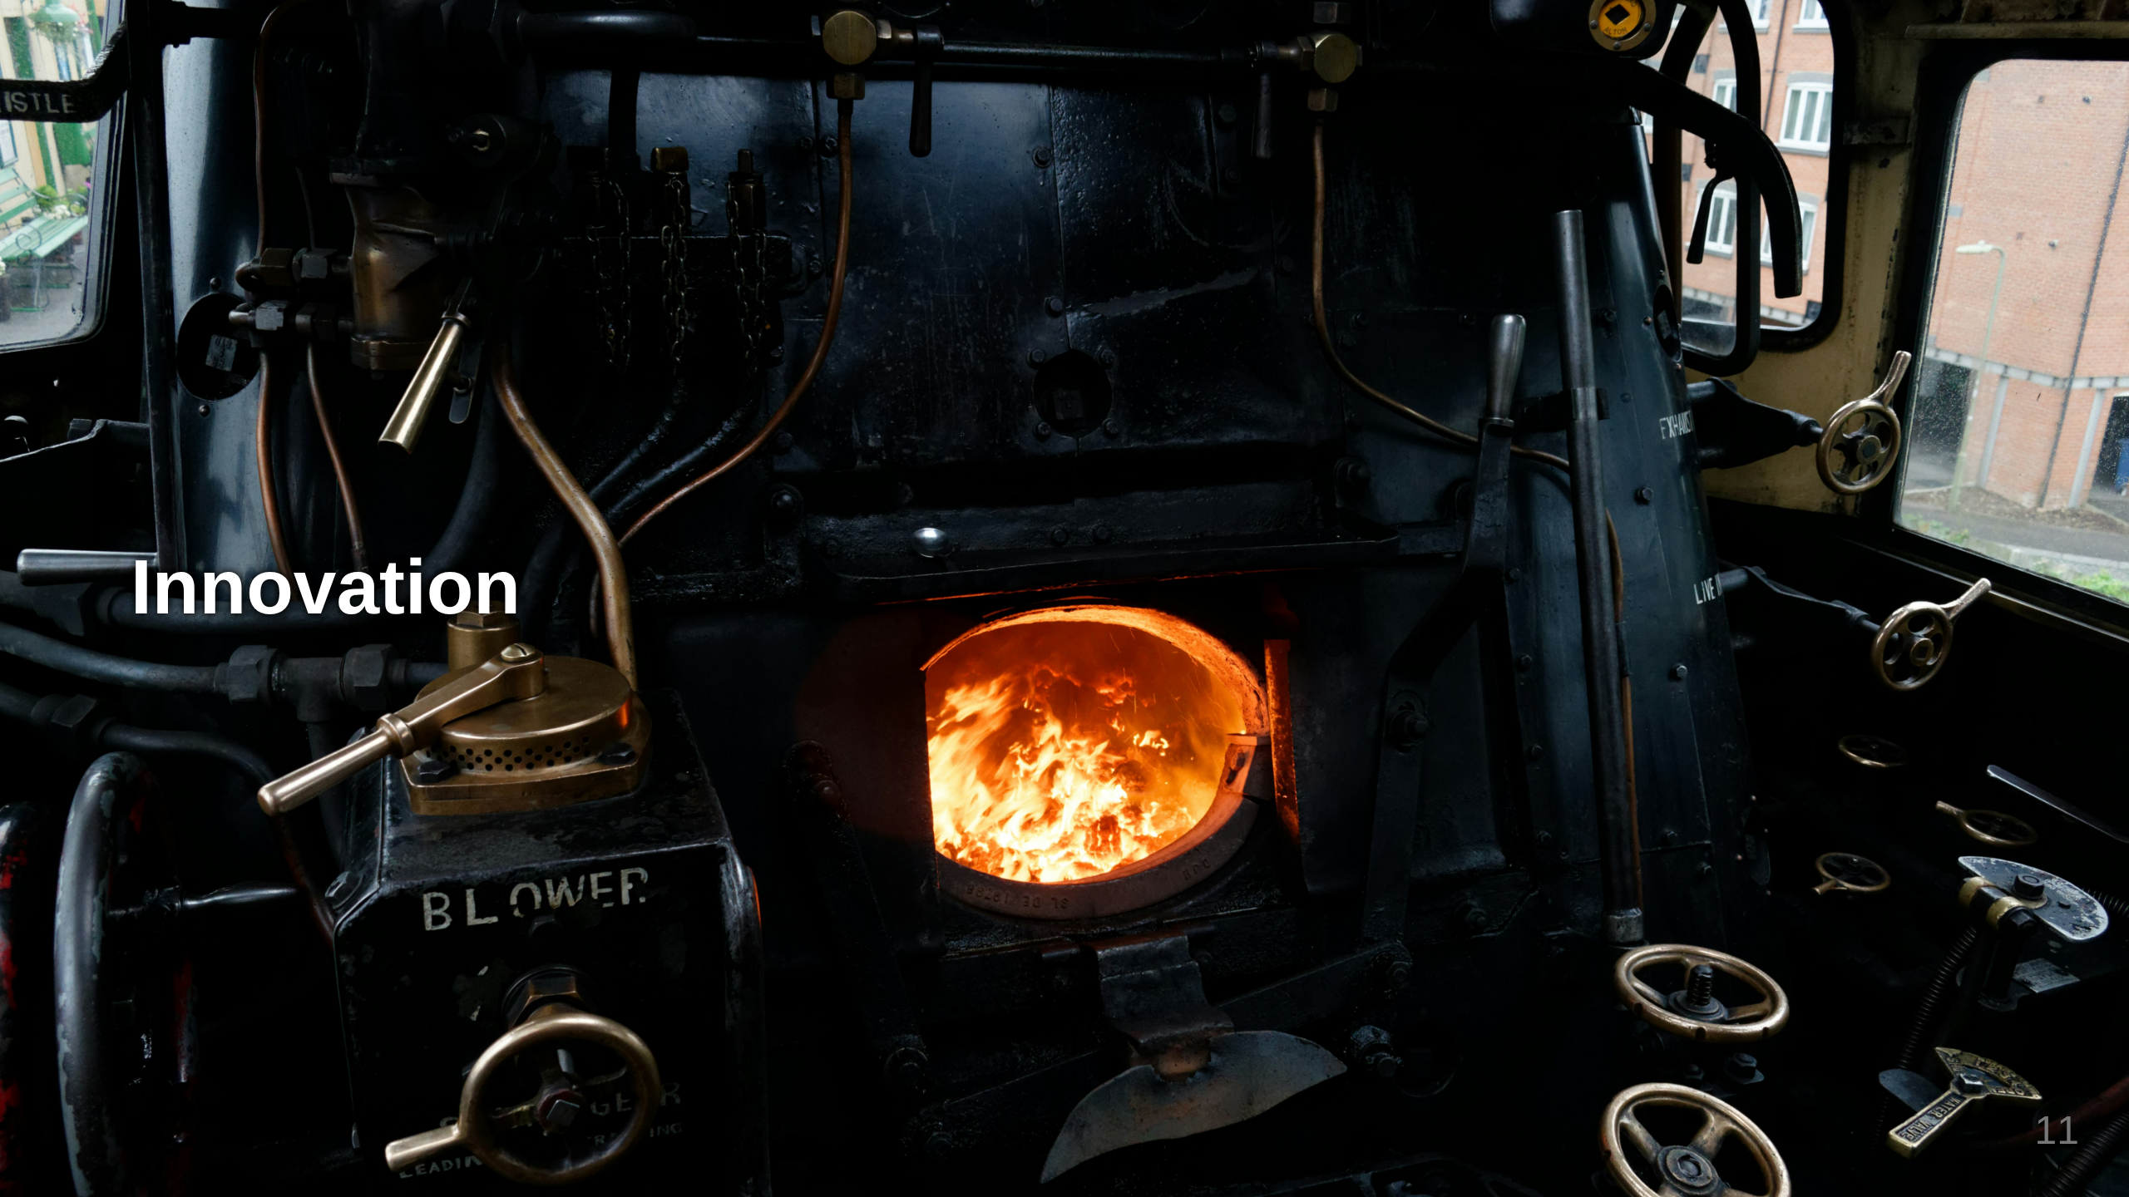
Notes:
Innovation is the successful implementation of creative ideas that create value. It's not just about having novel ideas—it's about executing them in ways that make a real difference, whether that's solving a problem, improving a process, or creating new opportunities. Innovation requires not just creativity and ideation, but also resources, persistence, and practical execution. The iPod was an innovation because it actually brought that "thousand songs in your pocket" vision to market and changed how people experienced music. Photo by <a href="https://unsplash.com/@shofukan?utm_source=unsplash&utm_medium=referral&utm_content=creditCopyText">Colin Avery</a> on <a href="https://unsplash.com/photos/black-metal-opened-charcoal-burner-InMS8UZ5Ki8?utm_source=unsplash&utm_medium=referral&utm_content=creditCopyText">Unsplash</a>

Slide 12

Notes:
Archimedes of Syracuse Eureka -> Density Photo by <a href="https://unsplash.com/@olenkasergienko?utm_source=unsplash&utm_medium=referral&utm_content=creditCopyText">Olena Bohovyk</a> on <a href="https://unsplash.com/photos/brown-glass-bottle-on-white-table-VUctfL2pN0Y?utm_source=unsplash&utm_medium=referral&utm_content=creditCopyText">Unsplash</a>

Slide 13
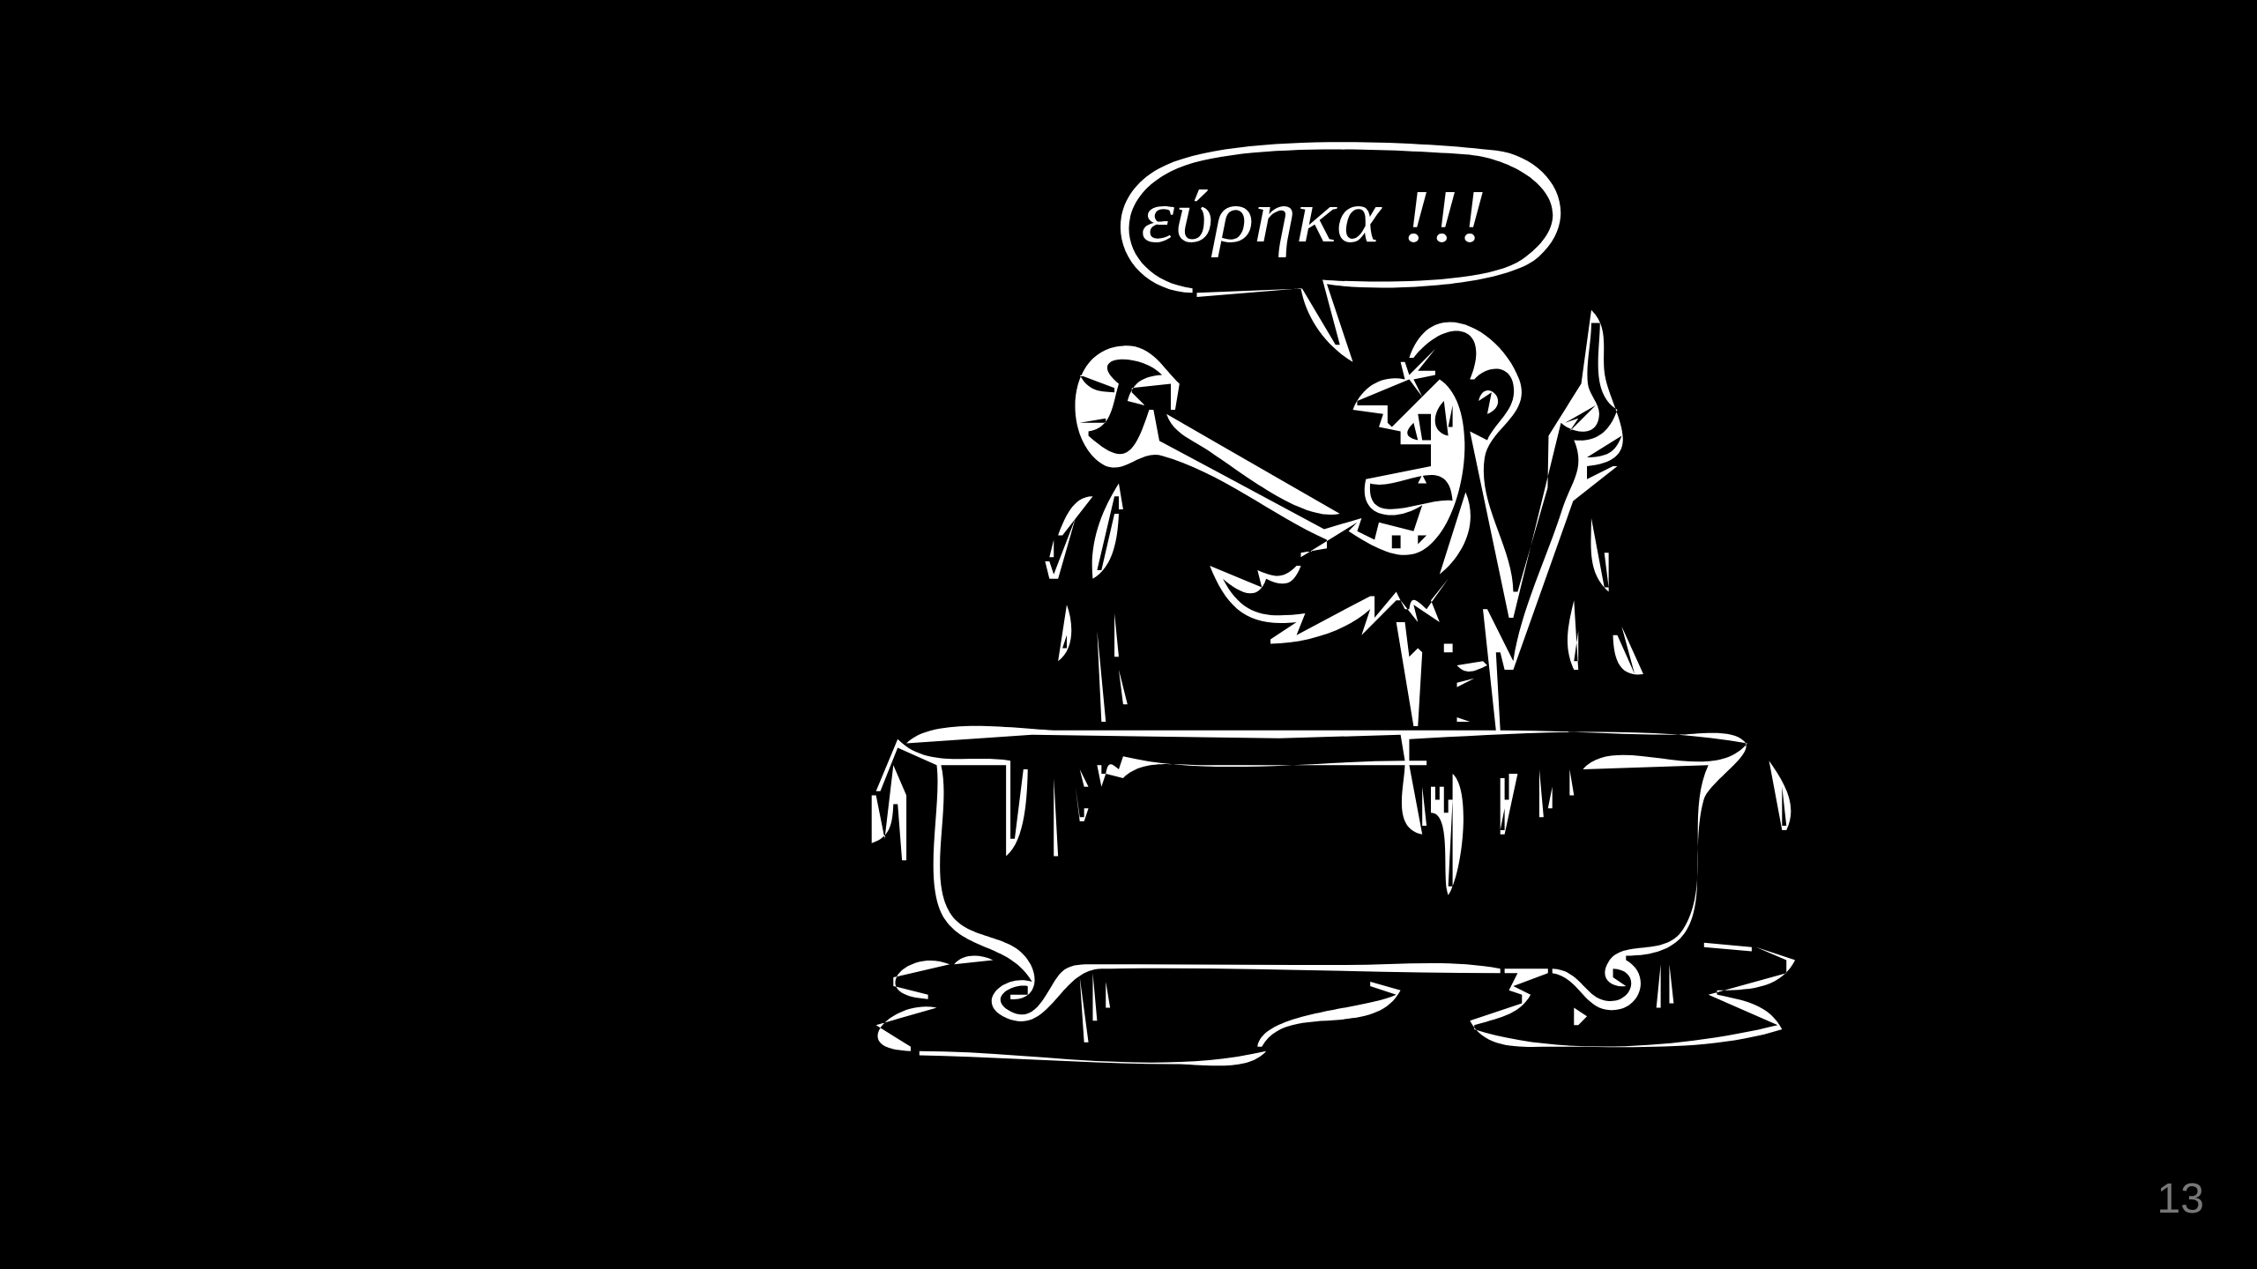
Notes:
Archimedes of Syracuse Eureka -> Density

Slide 14
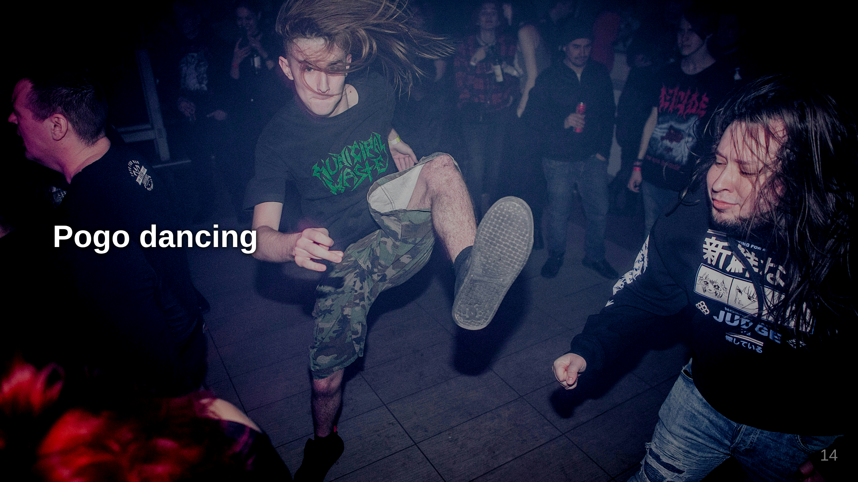
Notes:
1772 by English natural philosopher and chemist Joseph Priestley 1844 Horace Wells Photo by <a href="https://unsplash.com/@igrindphoto?utm_source=unsplash&utm_medium=referral&utm_content=creditCopyText">Evgeniy Smersh</a> on <a href="https://unsplash.com/photos/concert-crowd-moshing-enthusiastically-in-the-night-jVtSmbDZYk4?utm_source=unsplash&utm_medium=referral&utm_content=creditCopyText">Unsplash</a>

Slide 15
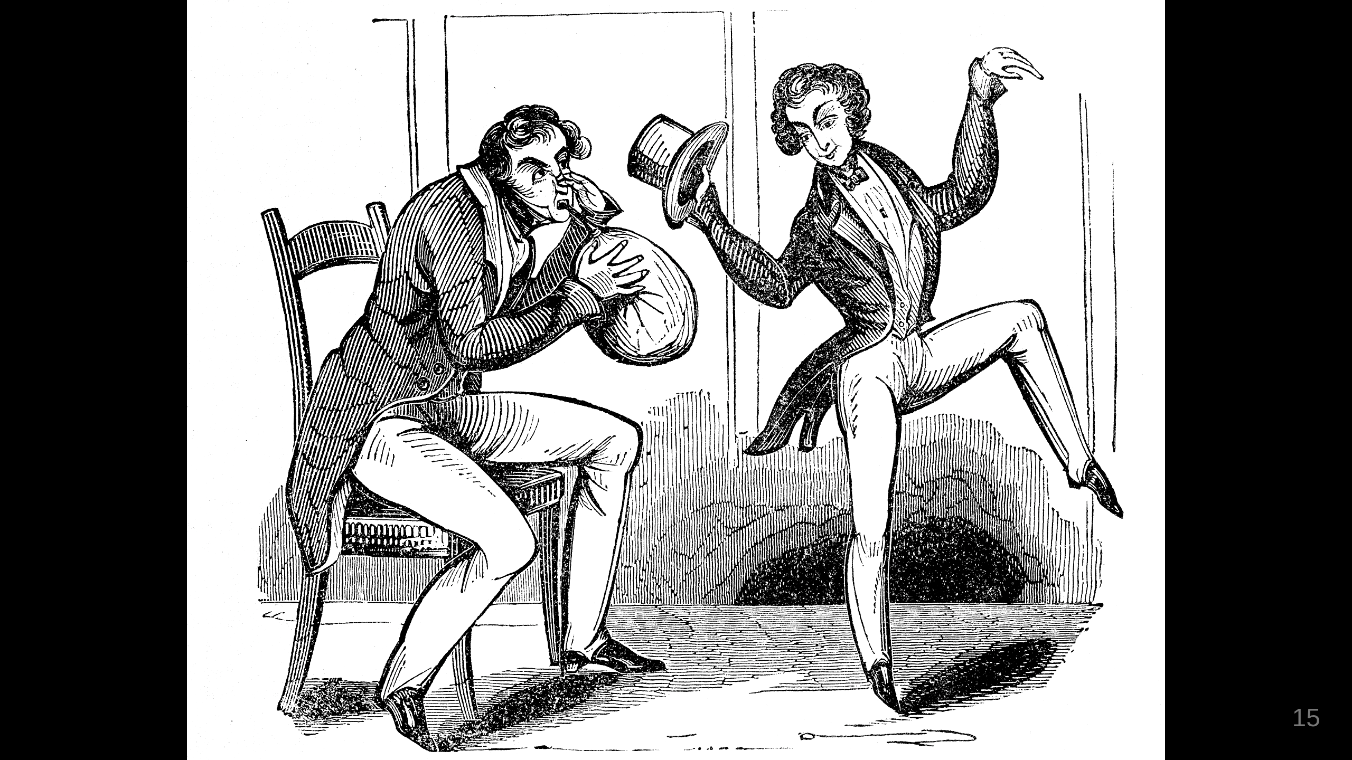
Notes:
Laughing gas 1772 by English natural philosopher and chemist Joseph Priestley 1844 Horace Wells

Slide 16
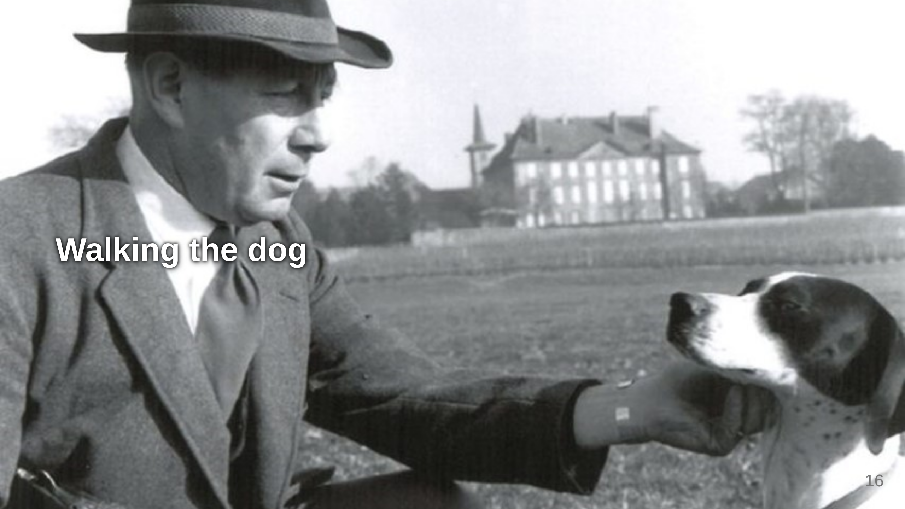
Notes:
1941 George de Mestral

Slide 17
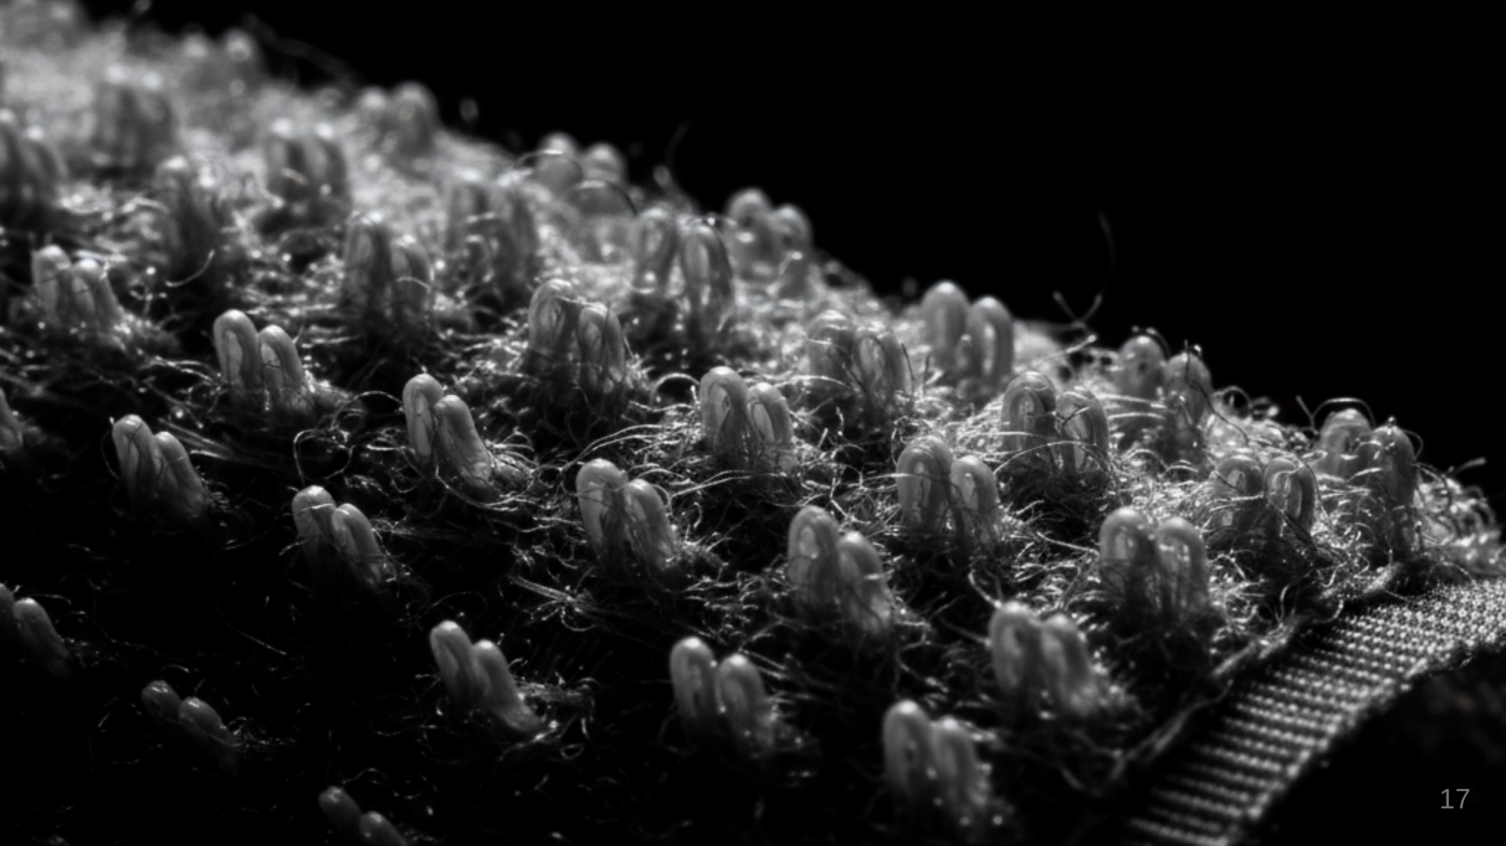
Notes:
Velcro 1941 George de Mestral Extreme close-up of Velcro, photorealistic, with dramatic, directional lighting creating deep shadows and highlights. The intricate hooks and loops are sharply in focus against a completely black, infinite background, emphasizing texture and depth.

Slide 18
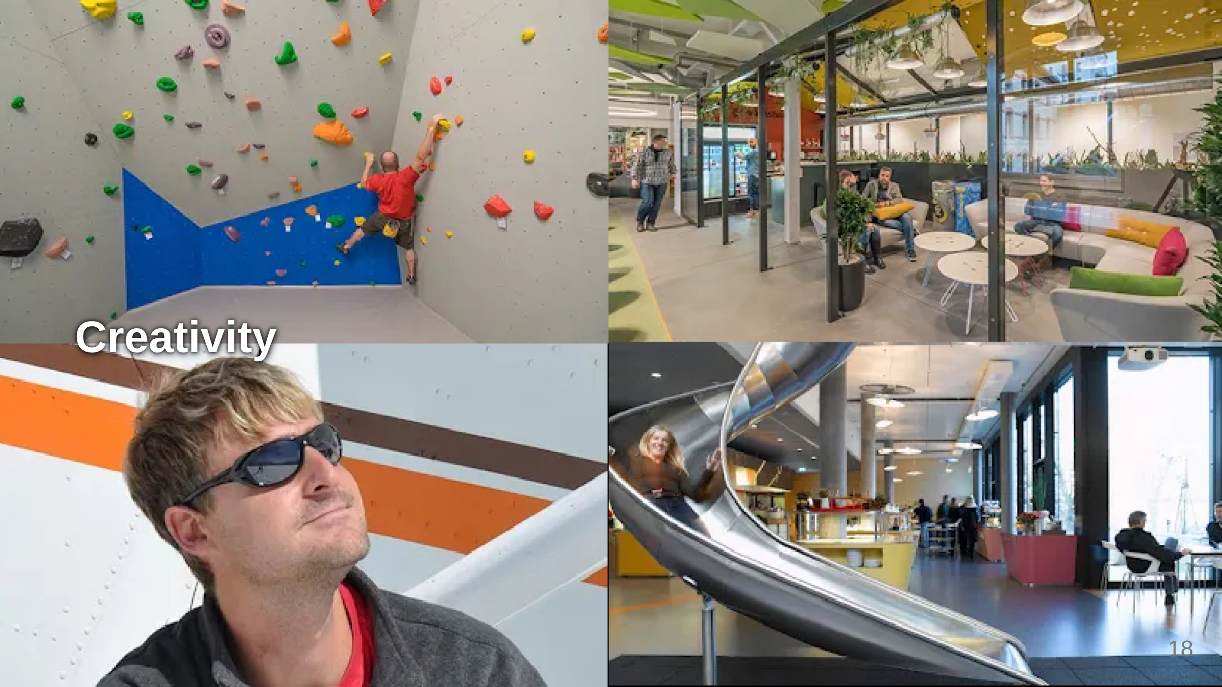
Notes:
"Create a work environment that motivates peak performance" ball pool table football creative furniture a walk in the "Baloise" Park

Slide 19
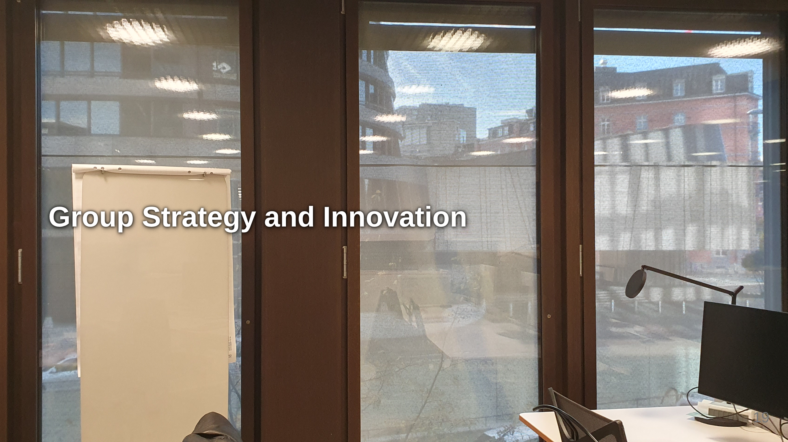
Notes:
"Create a work environment that motivates peak performance" ball pool table football creative furniture a walk in the "Baloise" Park

Slide 20
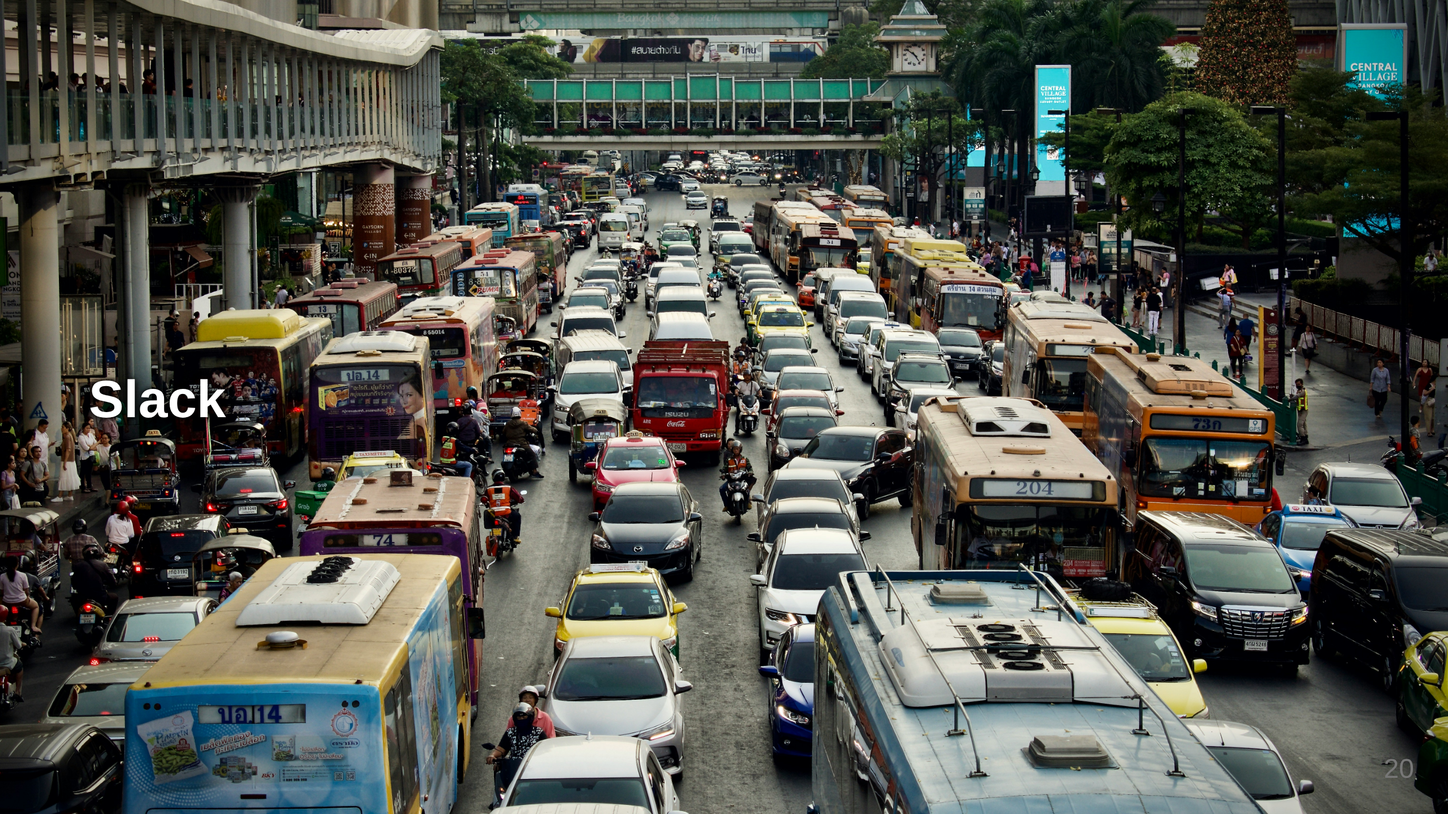
Notes:
Gold card Code camp Open Friday Hackathon Photo by <a href="https://unsplash.com/@itzshunnn?utm_source=unsplash&utm_medium=referral&utm_content=creditCopyText">shun idota</a> on <a href="https://unsplash.com/photos/cars-parked-on-the-side-of-the-road-during-daytime-cekJ1XXx1Rk?utm_source=unsplash&utm_medium=referral&utm_content=creditCopyText">Unsplash</a>

Slide 21
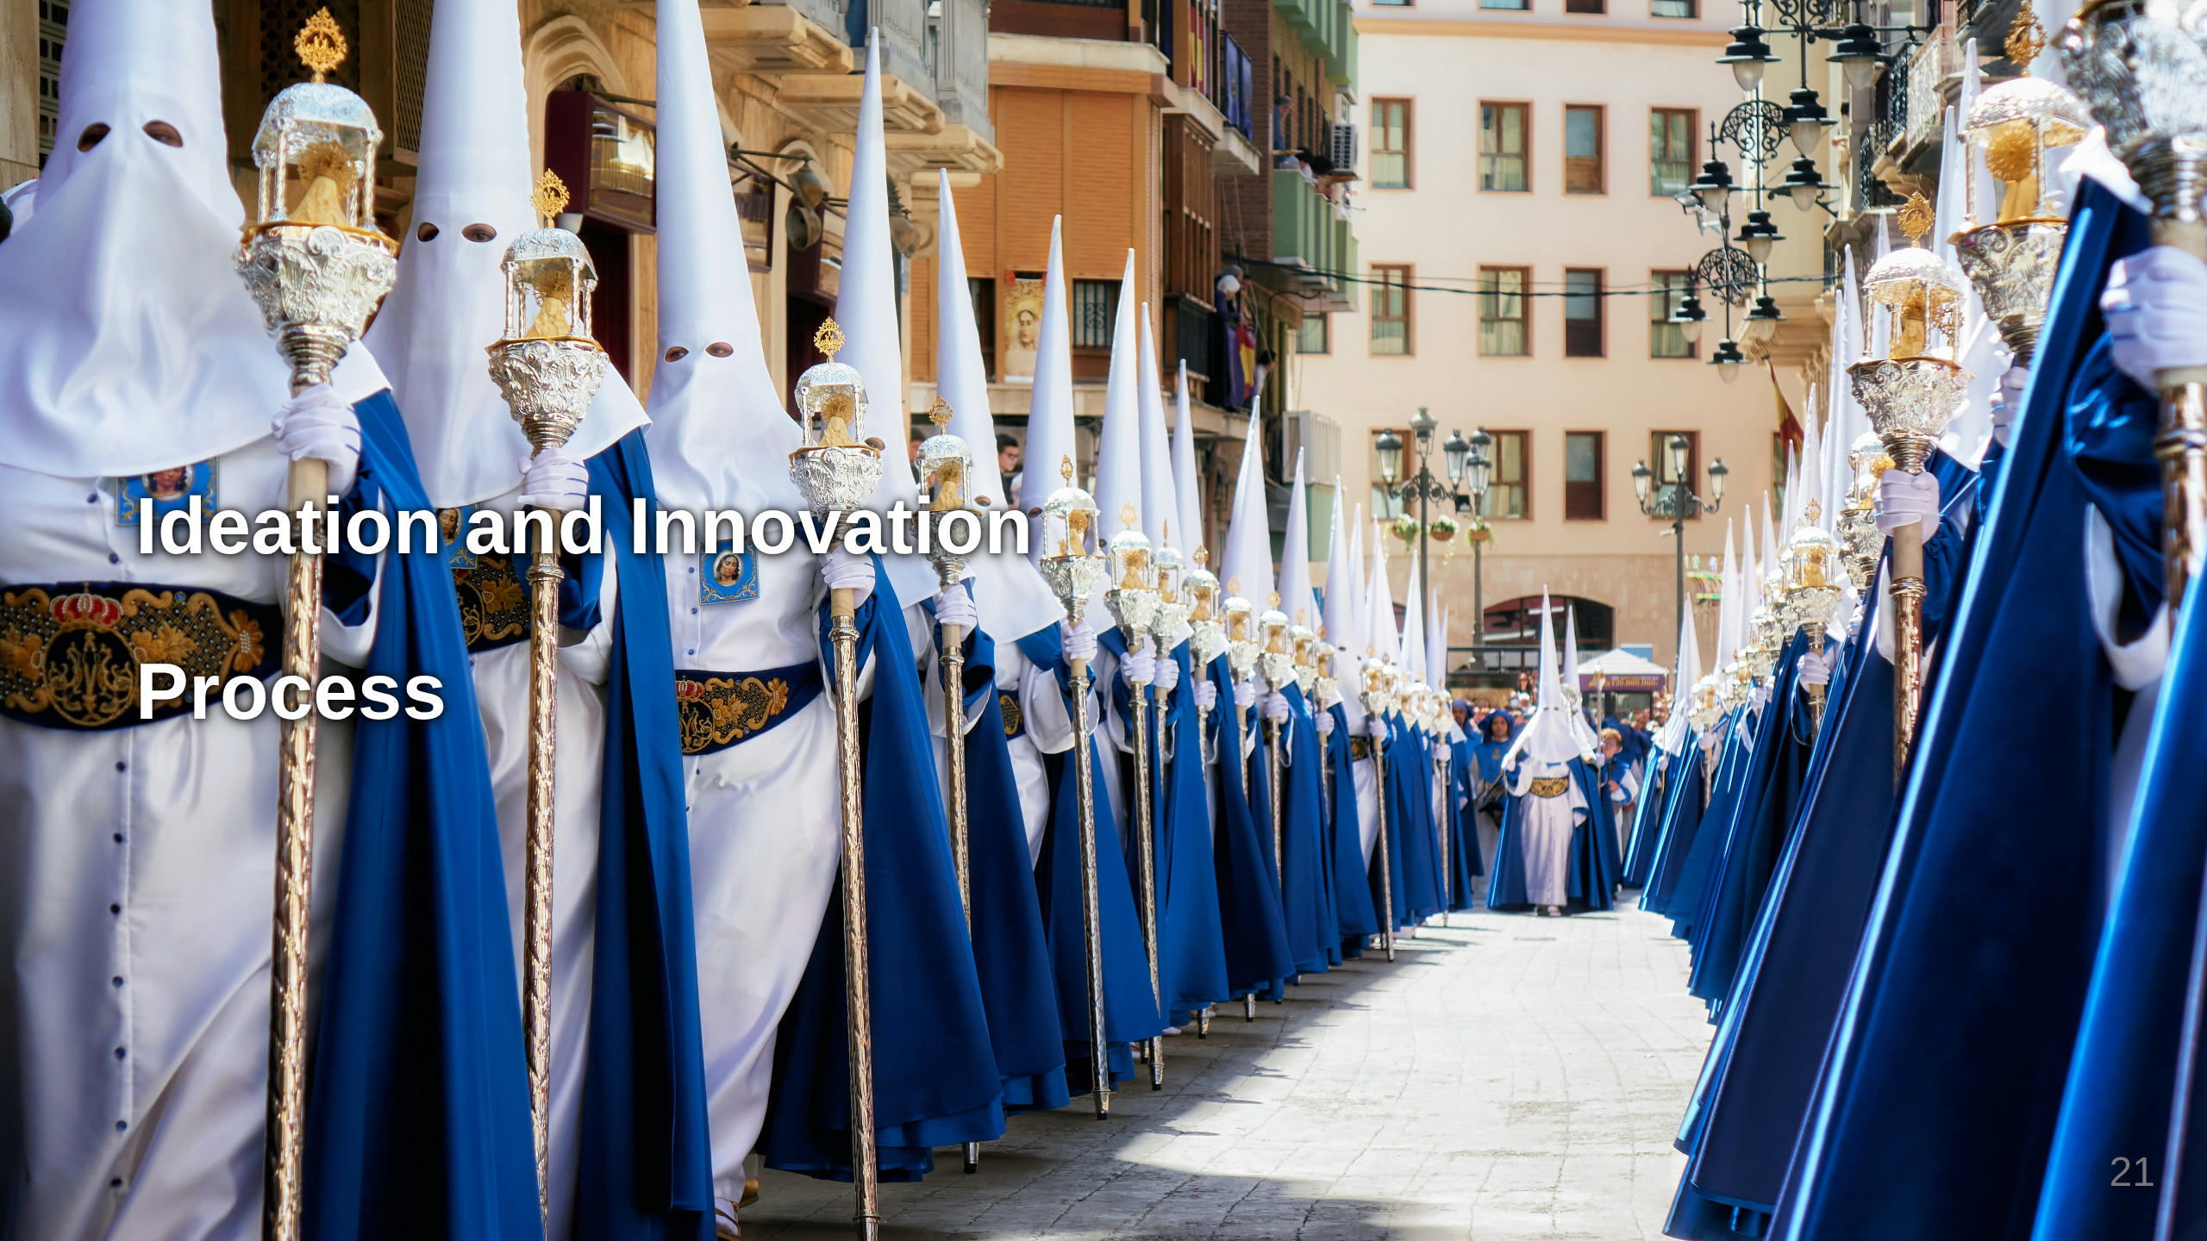
Notes:
Photo by <a href="https://unsplash.com/@estebanjvr?utm_source=unsplash&utm_medium=referral&utm_content=creditCopyText">Esteban Palacios Blanco</a> on <a href="https://unsplash.com/photos/a-row-of-blue-and-white-dresses-_CDeT66OOhc?utm_source=unsplash&utm_medium=referral&utm_content=creditCopyText">Unsplash</a> Pro cedere Progress Budget Voice of customer Innovation day

Slide 22
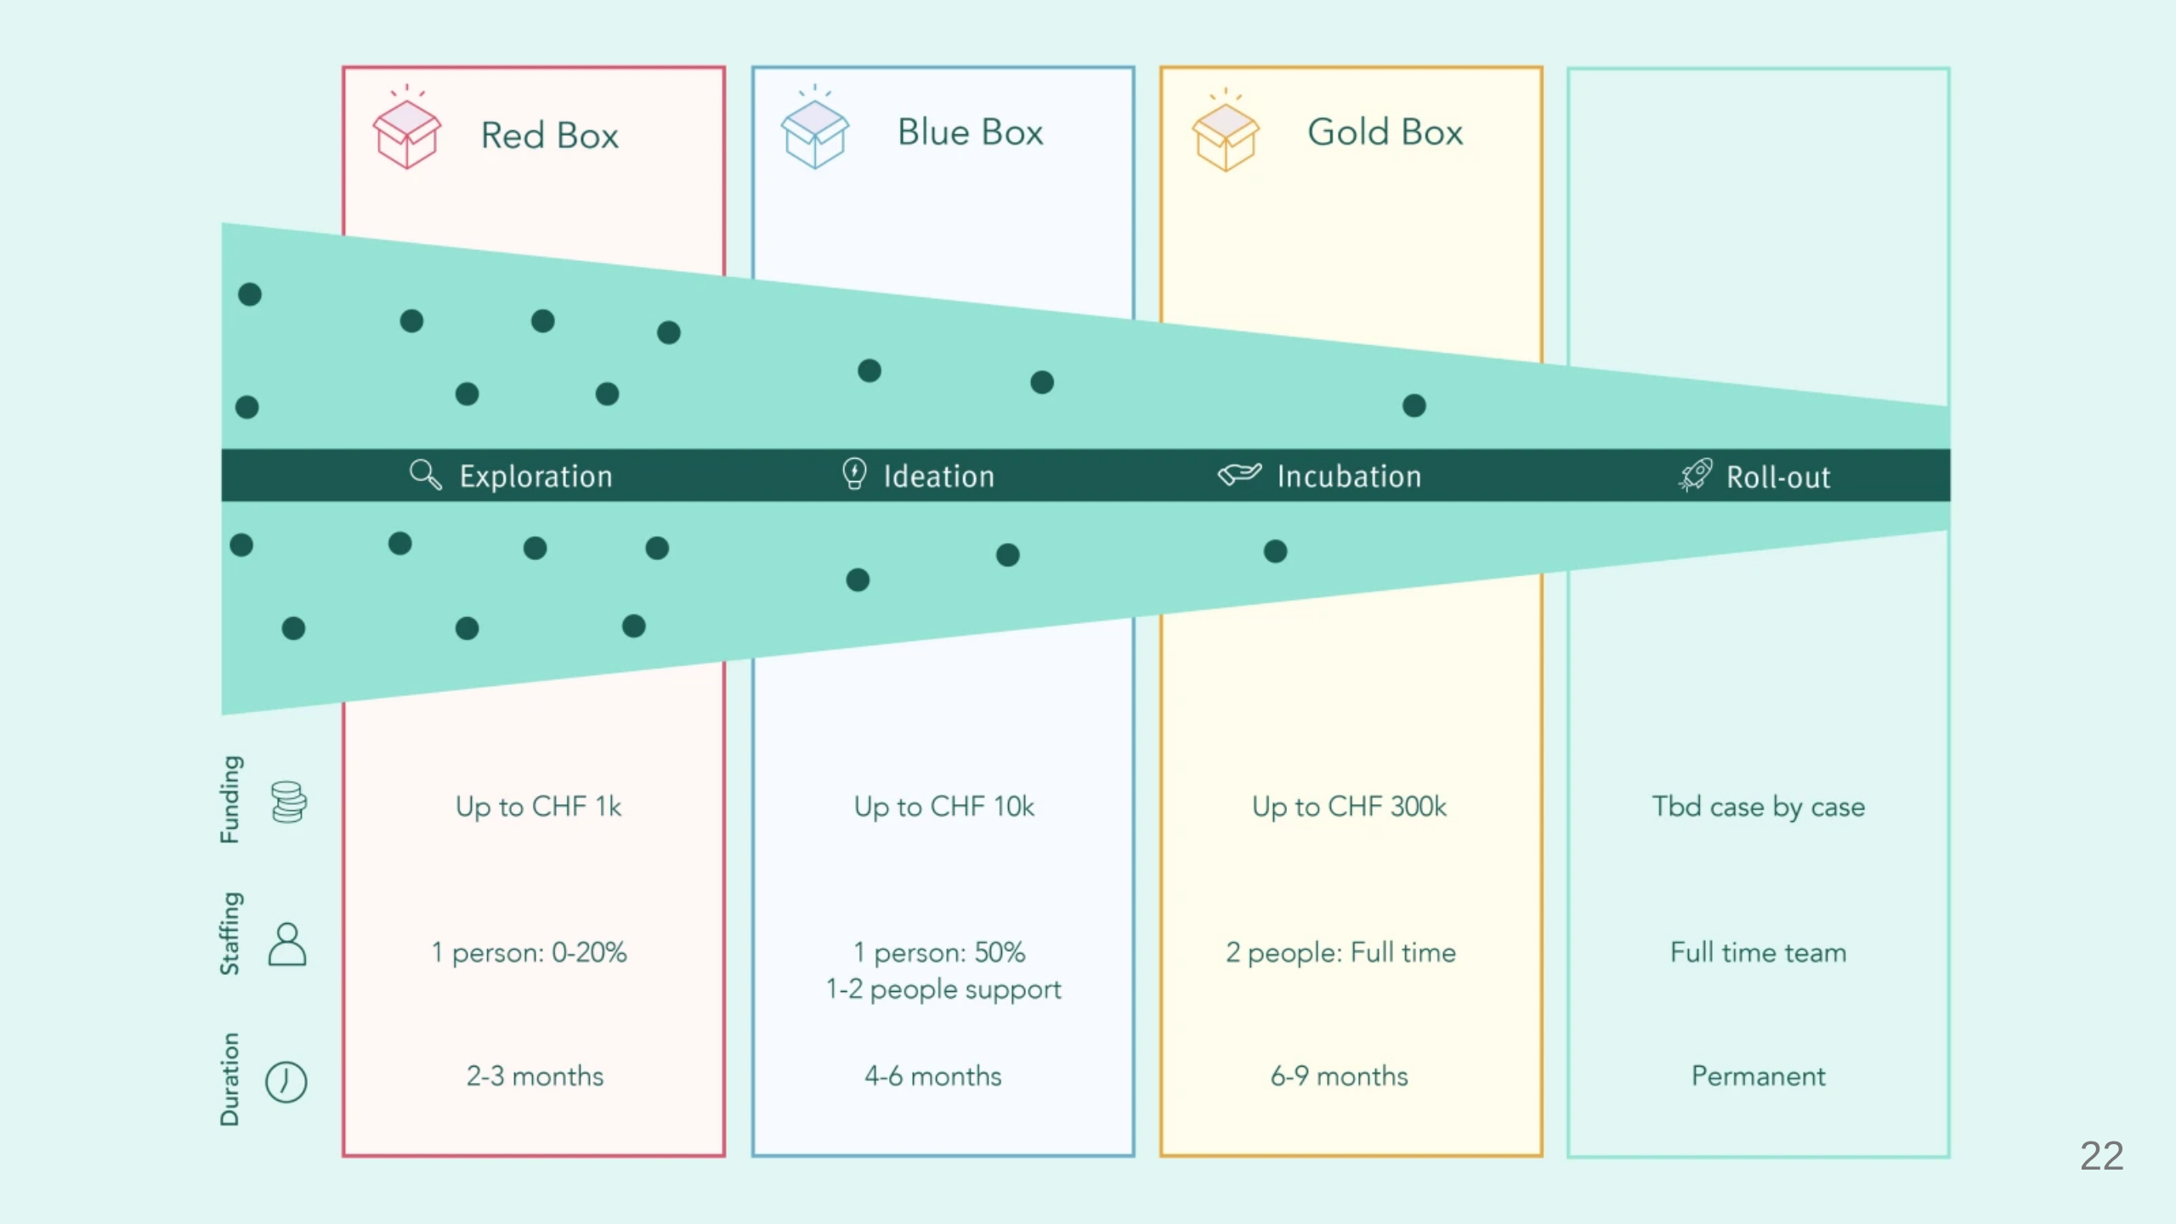
Notes:
Kickbox process , Innofunnel, Voice of Customer Kickbox party Pro cedere Budget & sponsorship Involve people -> scale

Slide 23

Notes:
Fail

Slide 24
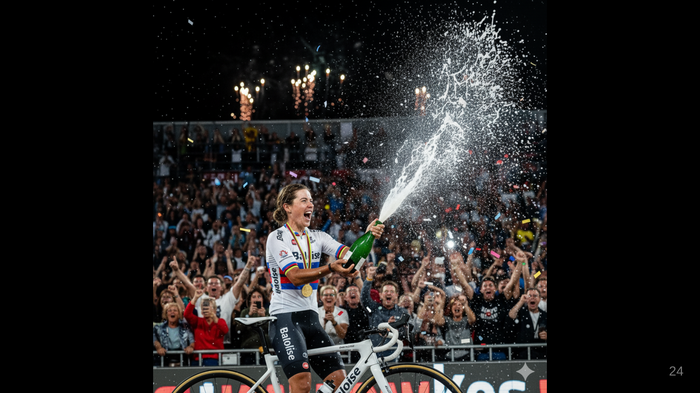
Notes:
# Celebrate "A hyper-realistic, high-resolution press photograph capturing the peak moment of a grand celebration. Focus on a female victorious cyclist in sharp detail, as if taken by a professional sports photographer. She should be wearing a cycling jersey with a prominent Baloise logo, clearly visible on the chest of her jersey. She is holding a champagne bottle mid-spray, celebrating her win. The background features a blurred but recognizable crowd, expressing raw, ecstatic emotion – mouths open in cheers, hands raised in jubilation. Confetti is frozen in motion, and stadium lights glint off metallic surfaces. Emphasize authentic expressions, dynamic action, and true-to-life lighting, avoiding any artificial or stylized elements. The image should feel immediate, unposed, and perfectly timed, like a snapshot from a live event.

Slide 25
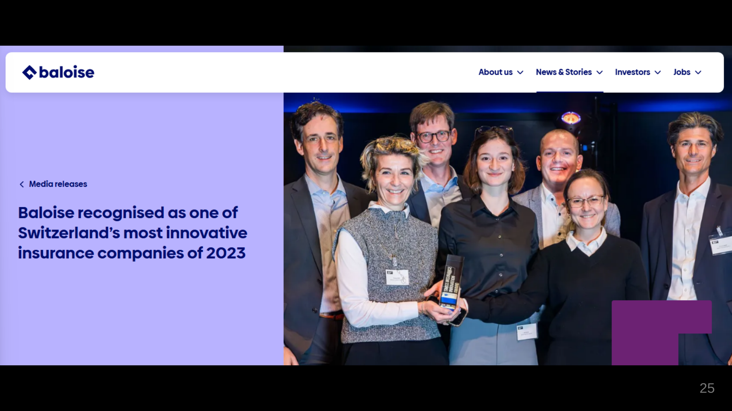
Notes:
"A hyper-realistic, high-resolution press photograph capturing the peak moment of a grand celebration. Focus on a female victorious cyclist in sharp detail, as if taken by a professional sports photographer. She should be wearing a cycling jersey with a prominent Baloise logo, clearly visible on the chest of her jersey. She is holding a champagne bottle mid-spray, celebrating her win. The background features a blurred but recognizable crowd, expressing raw, ecstatic emotion – mouths open in cheers, hands raised in jubilation. Confetti is frozen in motion, and stadium lights glint off metallic surfaces. Emphasize authentic expressions, dynamic action, and true-to-life lighting, avoiding any artificial or stylized elements. The image should feel immediate, unposed, and perfectly timed, like a snapshot from a live event.

Slide 26

Notes:
# Humans innovate Hire the best Make them better Can AI innovate? AlphaFold

Slide 27
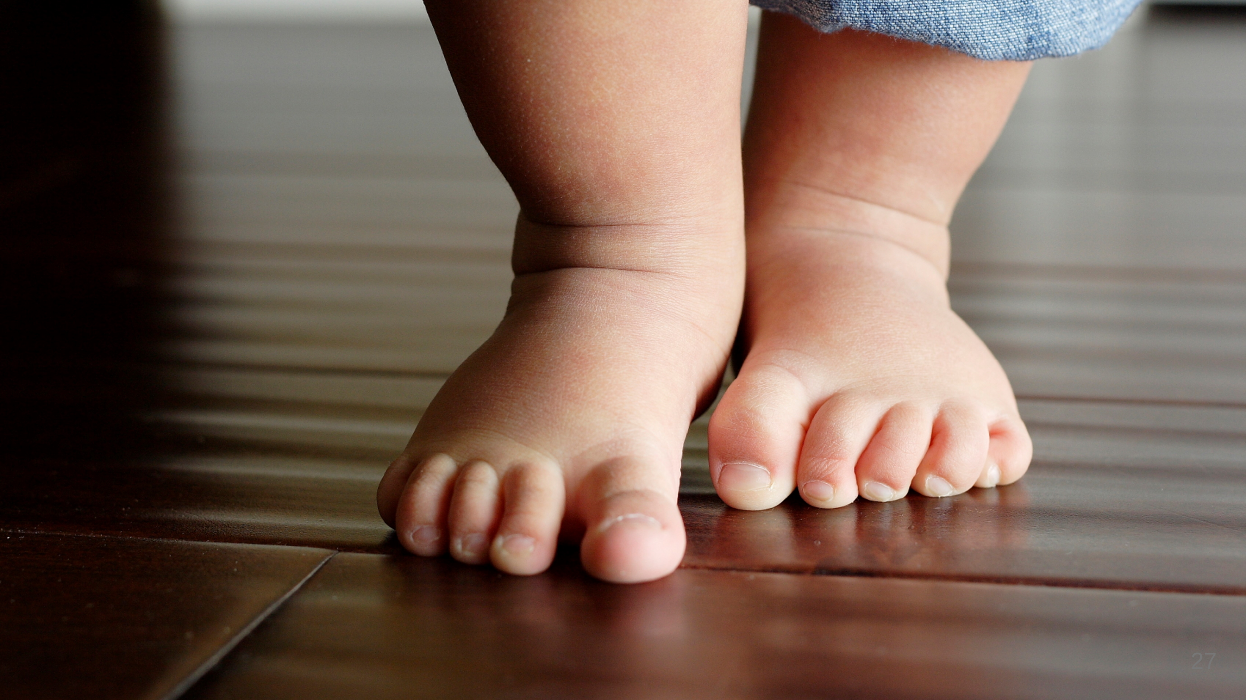
Notes:
Did I just listen to a keynote telling me to open the windows if I want innovation? Do any all Baby steps

